Slide 1

Team 19

Slide 2
Team Member
Tran Huynh An Duy
R Mudiyanselage Nayananjali Hansika Kumari Babalagama
Vo Dai Trang
Nuwani Vayama Nadhikani Fernand
Lu Liu

Slide 3
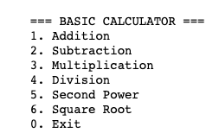
Calculation program
Build a basic calculator. The program should have a menu displayed for the user to choose from, where are listed basic operations:addition,subtraction multiplication,division, second power, square root, exit.The program should allow the user to choose the desired operation over and over again until user chooses to quit using it.

Slide 4
Why team 19 choose this project?
Calculator is the basic application which we can re-collect all knowledge which studying in python and apply
Easy to understand and execute for every member in team

Slide 5
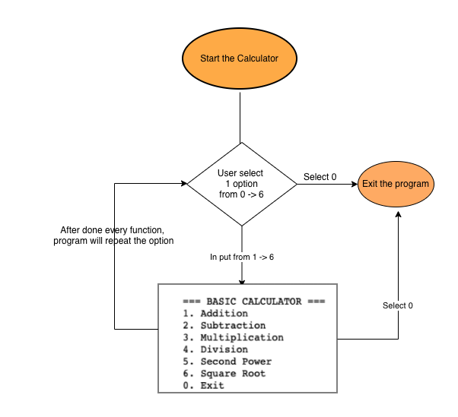
Calculation workflow

Slide 6
Challenges
Planning tasks for every members
Everyone have difference timezone, therefore need to have an appropriate meeting schedules
Logic of code need to be covered the wrong input from end users. Ex: input text instead of number

Slide 7
Teamwork

Slide 8
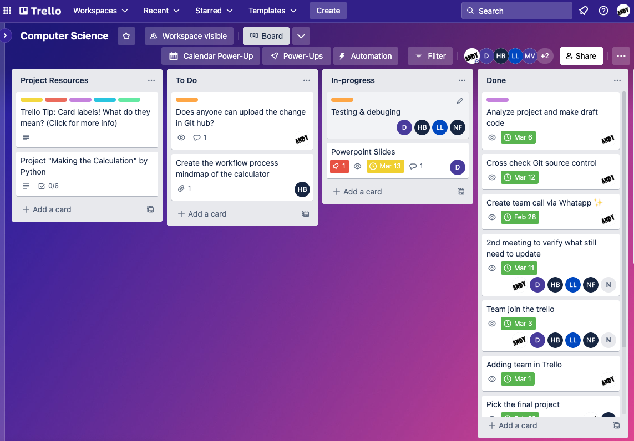
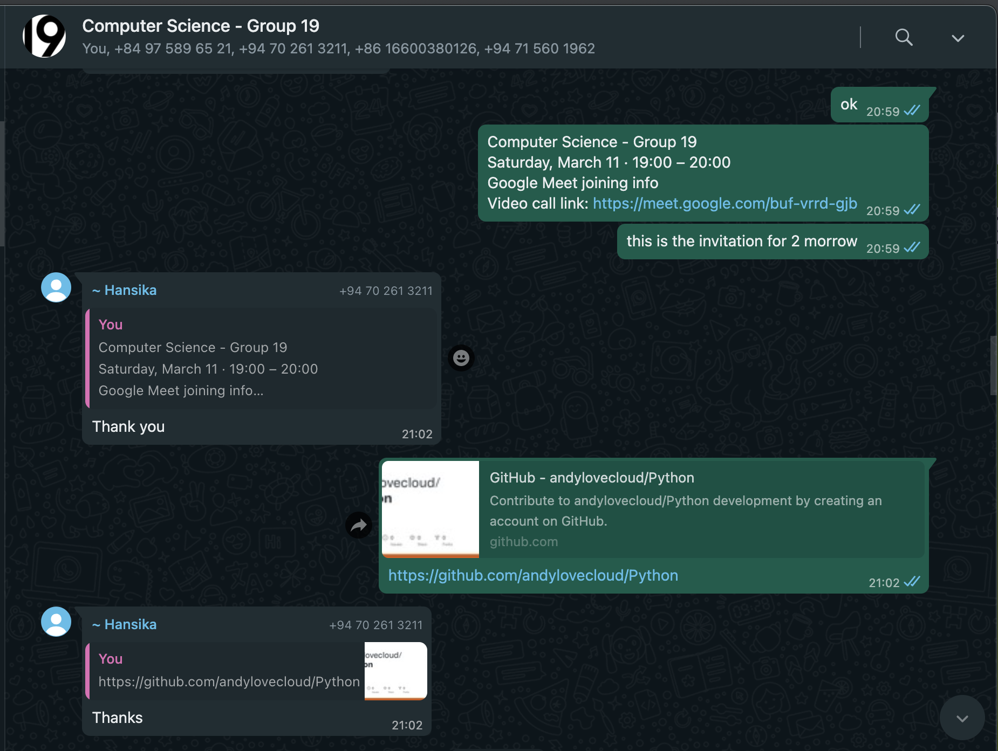
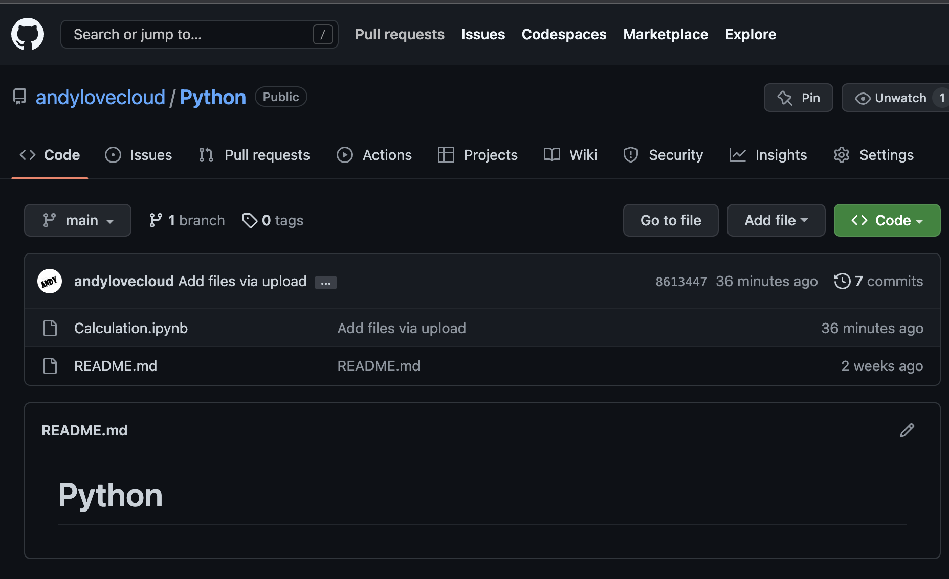
Flatform to follow tasks and communication

Slide 9
Evaluation
What went well?
Team well done for contributing in collaboration and communication
Program could satisfy all requirement functionalities from the topic
Improvement points:
The validation of input values should check as well after user choose any option.
Team need to research for other source control programs (ex: Google colab)
Practice more in Trello to update task status efficiently

Slide 10
Thank you

